Slide 1
Sir Flinders Petrie
Michael Malatesta

Slide 2
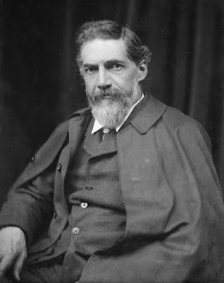
Who was he
Egyptologist
Born on June 3 1853
Born in Charlton, England
Died on July 28 1942
Died in Jerusalem, Israel

Slide 3
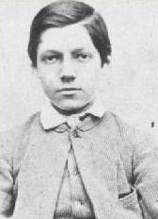
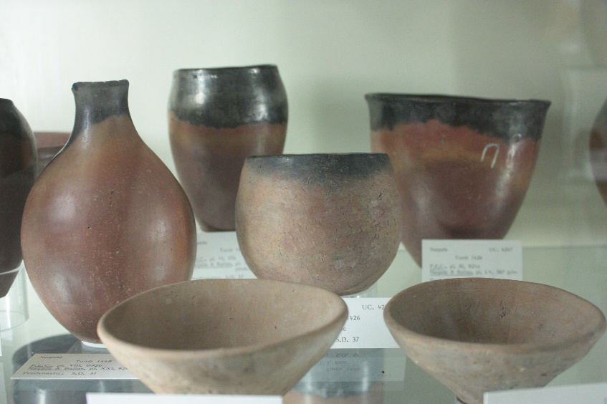
Childhood
Grandson of Captain Mathew Flinders
Led the first circumnavigation of Australia
Raised Christian
Homeschooled
No formal education
Insisted at a young age that all objects have value while excavating

Slide 4
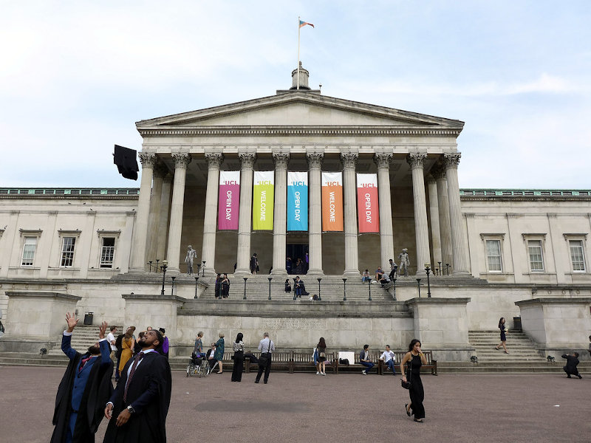
Academic Career
Held the position of “Edwards Professor of Egyptian Archaeology” and Philology at University College London
Professor Amelia Edwards set up the position for him
Supported Petrie’s studies since 1880
Edwards was known for having an incredible ability for visual memory
Elected to be a “Fellow of the Royal Society”
He was knighted in 1923 for services in British archaeology and Egyptology

Slide 5
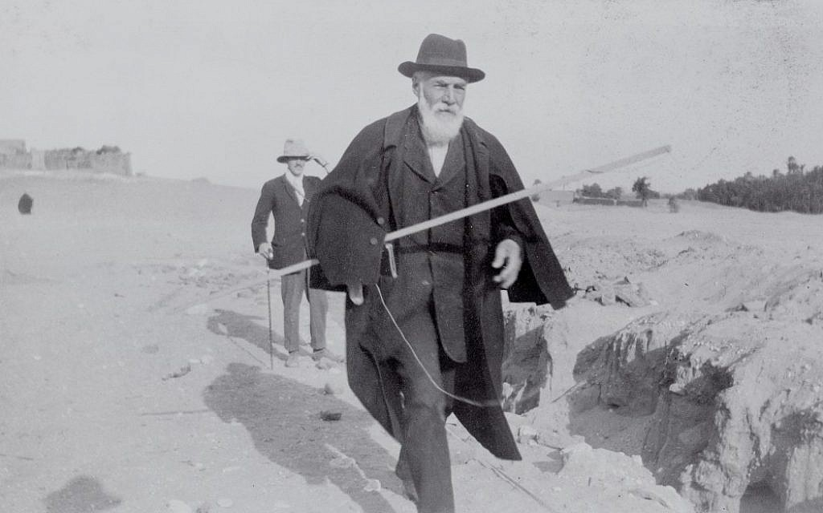
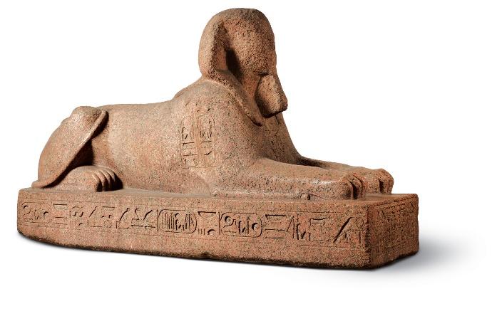
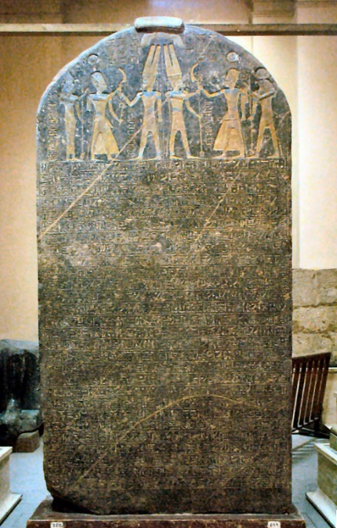
Archaeology career
Started excavating in 1880 at Giza
First to properly investigate construction
His workers liked his methods as they found more significant findings
Discovered the Merneptah Stele
Major discovery
First mention of Israel in Egyptian text
Self proclaimed “greatest discovery”
Continued excavations until 1938
Worked in Palestine and Jordan towards the end of his life

Slide 6
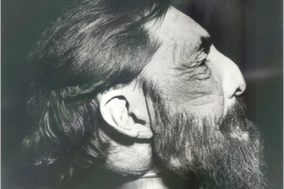
Death
Petrie died in Jerusalem in 1942
Body was buried in Jerusalem
Head was meant to be donated to the Royal College of Surgeons of London
Due to WWII, his head wound up lost for many years in the College basement

Slide 7
Timeline
Excavation
at Tanis
Discovery of the
Merneptah Stele
Knighted for
Egyptology
Moved to
Jerusalem
Rediscovery
of lost head
Birth
1853 1880 1884 1890 1896 1902 1923 1928 1933 1942 1989
Elected as a
Fellow of the
Royal Society
First Survey
at Giza
First excavation
in Palestine
Finished creating
sequence dating
Death

Slide 8
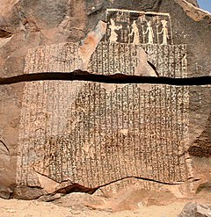
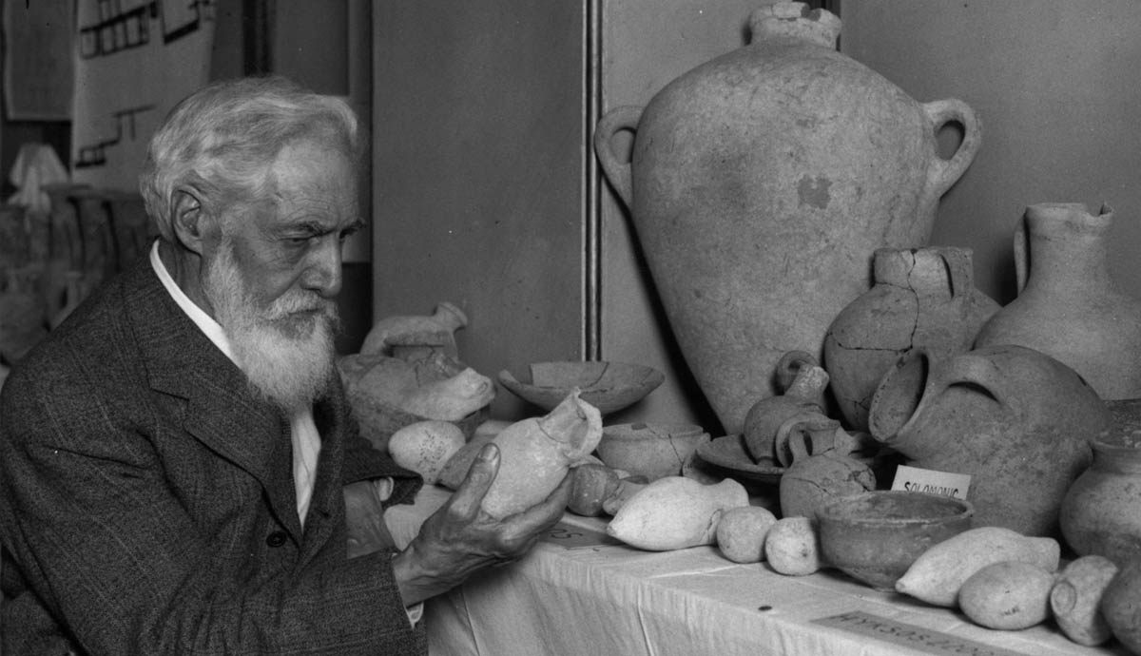

Merneptah
Stele
Famine Stele
Petrie and some pottery

Slide 9
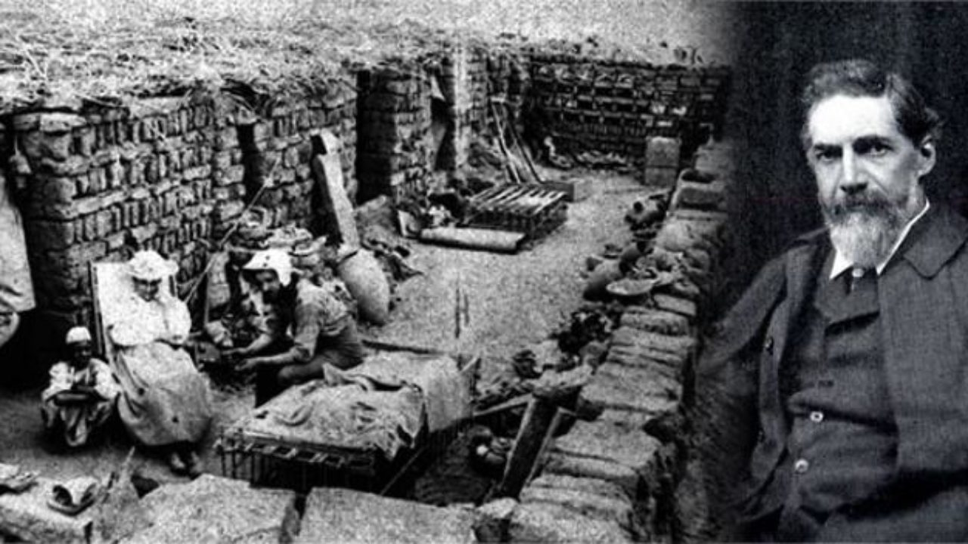
Significance
Significantly more excavations began to focus on everyday objects
Created a method of dating by using pottery
Seriation
Different styles of pottery related to different time eras
Discovered the Merneptah Stele

Slide 10
Bibliography
Google Images
William Matthew. Flinders Petrie, Seventy Years in Archaeology, H. Holt and Company 1932
https://www.ucl.ac.uk/museums-static/digitalegypt/archaeology/petriedigsindex.html
“Flinders Petrie.” In Wikipedia, January 6, 2021. https://en.wikipedia.org/w/index.php?title=Flinders_Petrie&oldid=998765798.
Sparks, Rachael Thyrza. “Flinders Petrie Through Word and Deed: Re-Evaluating Petrie’s Field Techniques and Their Impact on Object Recovery in British Mandate Palestine.” Palestine Exploration Quarterly 145, no. 2 (June 1, 2013): 143–59. https://doi.org/10.1179/0031032813Z.00000000049.
“William Matthew Flinders Petrie - New World Encyclopedia.” Accessed February 16, 2021. https://www.newworldencyclopedia.org/entry/William_Matthew_Flinders_Petrie#Major_Works.

Slide 11
Bibliography cont
https://www.timesofisrael.com/in-jerusalem-a-crowd-turns-out-to-honor-an-archaeological-giant-flinders-petrie/
https://en.wikipedia.org/wiki/Sequence_dating#:~:text=Sequence%20dating%20is%20a%20method,to%20use%20seriation%20in%20Egyptology.
https://www.oxfordartonline.com/groveart/view/10.1093/gao/9781884446054.001.0001/oao-9781884446054-e-7000066778#oao-9781884446054-e-7000066778
https://www.tandfonline.com/doi/full/10.1179/0031032813Z.00000000049?scroll=top&needAccess=true
https://en.wikipedia.org/wiki/Flinders_Petrie#cite_note-8

